Slide 1

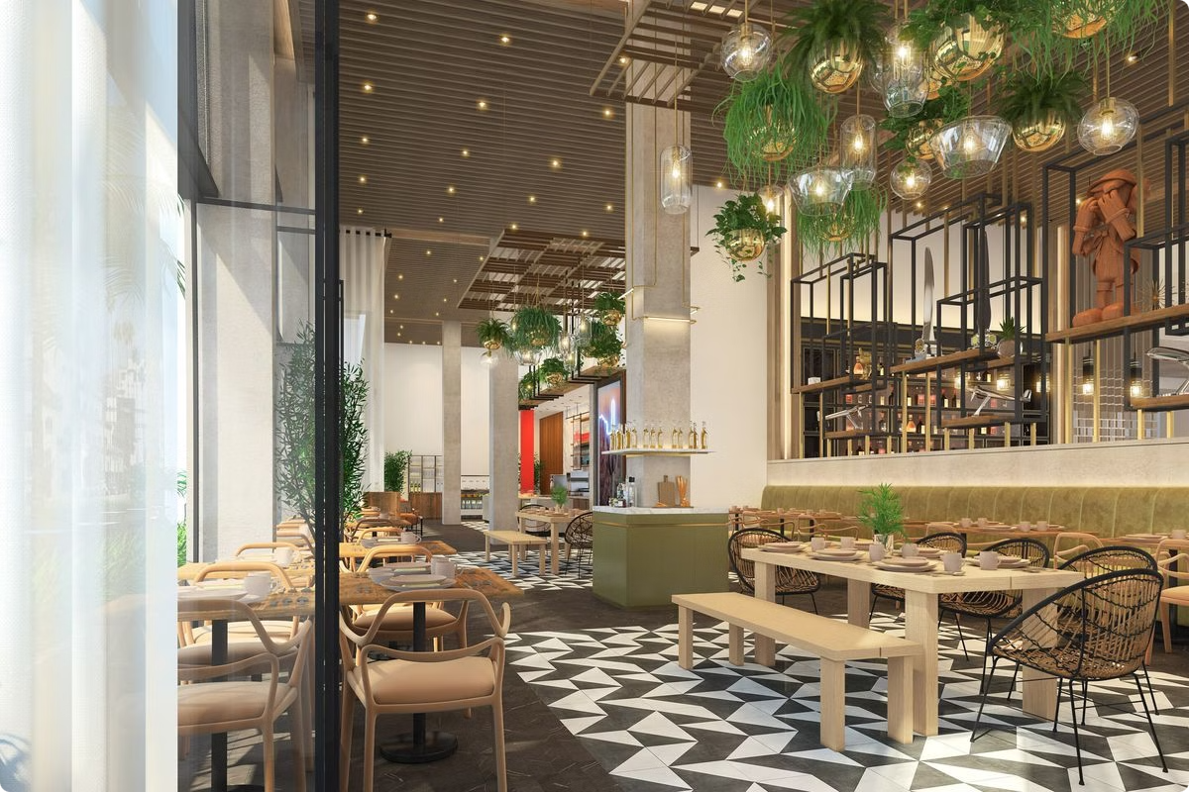
Pizza & Beverages Order and Billing System.
-23IT011 Dhruvin Bhimani
-23IT015 Yugm Choudhary
- 23IT020 Dev Dadhania

Slide 2

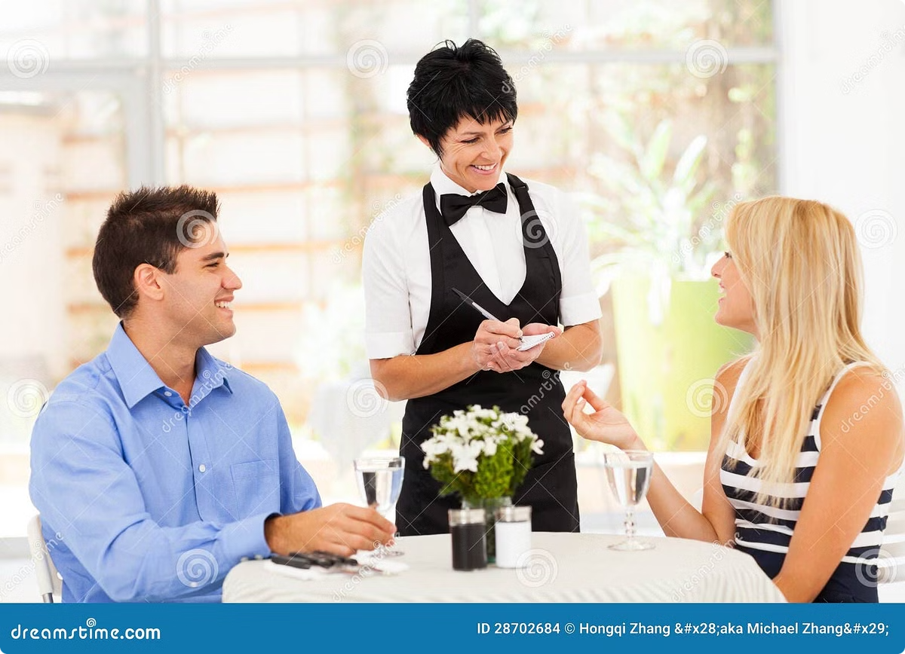
Overview
Supporting payment integration, allowing for smooth transactions.
Provides a user friendly interface for selection of menu
Special feature to cancel and pay the bills
Includes the special festival offers and All payment methods
Definition
Role
Error Reduction during the ordering
Real time availability of the Menu items
Efficient and faster compared to orthodox method
Fast Data Connection and Management
Key Features
Key features include order taking, billing, customer service, reporting, and analytics, enabling hotels to optimize operations, reduce costs, and improve overall efficiency.

Slide 3
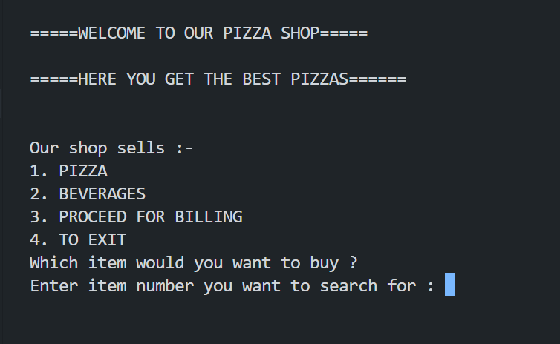
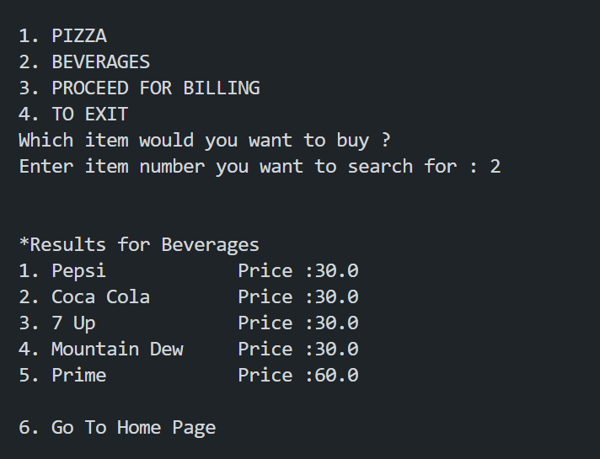
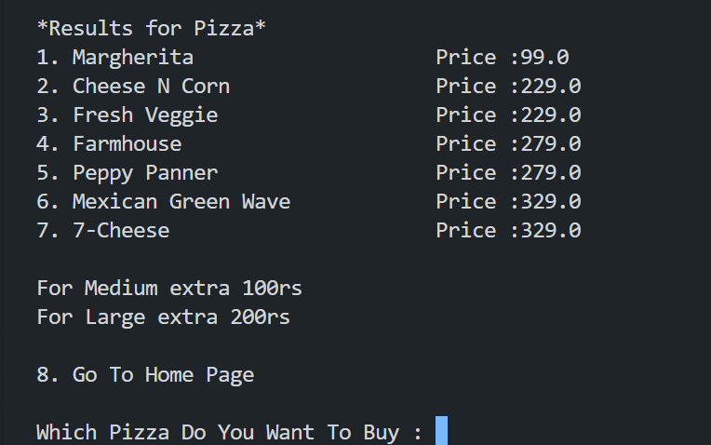
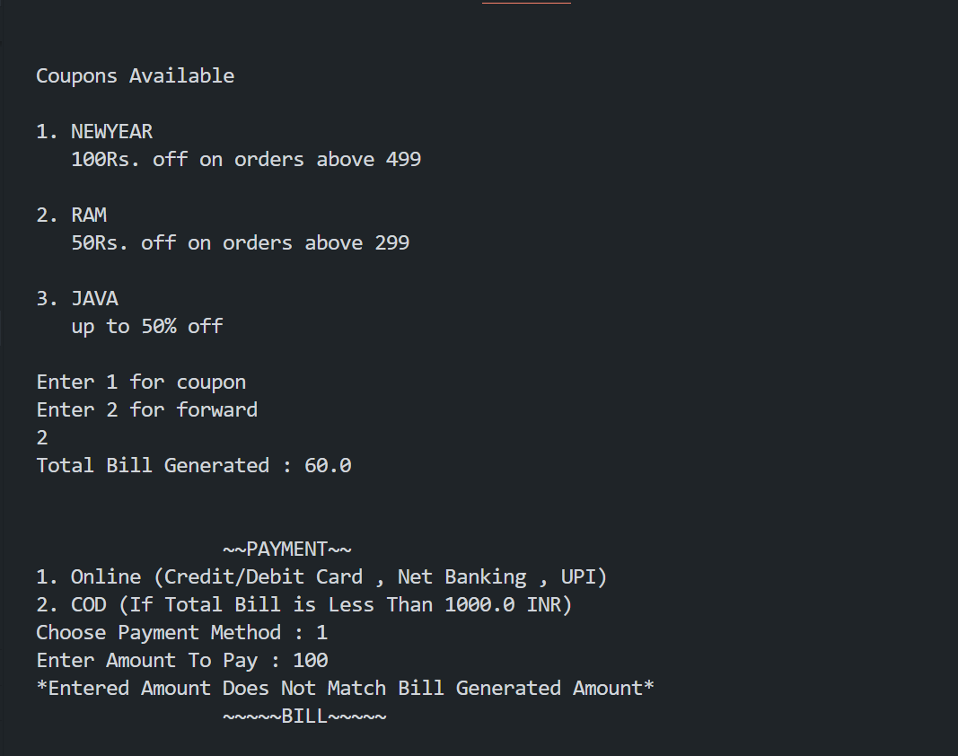

Slide 4

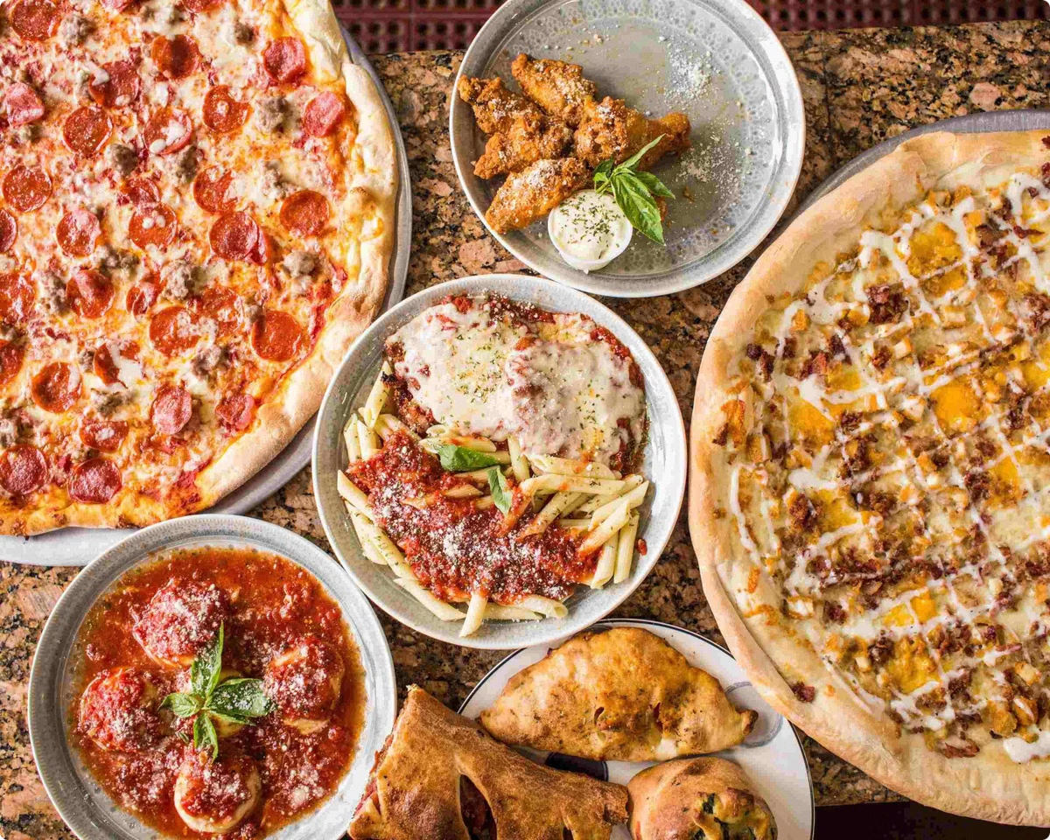
Key Features of Pizza & Beverages Ordering System
1
User-Friendly Interface
2
Real-Time Order Tracking
A user-friendly interface simplifies the ordering process for both guests and staff, allowing for easy navigation and efficient order placement.
Real-time tracking provides transparency throughout the order process, allowing guests to monitor the status of their orders and ensuring timely delivery.
3
Menu Management
4
Integrated Billing
The system allows for easy menu management, enabling hotels to update their offerings, add new items, and modify prices effortlessly.
Integrated billing capabilities streamline the payment process, enabling seamless order completion and accurate invoicing.

Slide 5
Order Entry and Customization
Order Entry
Customization
Order Confirmation
The system provides a simple and intuitive platform for order entry, allowing guests to select items from the menu, specify quantities, and add any special requests or dietary preferences.
Customization options allow guests to personalize their orders by choosing toppings, sauces, sizes, and other preferences, enhancing their dining experience.
Upon order completion, the system generates a confirmation with all the details, ensuring accuracy and providing a record for both the guest and the hotel.

Slide 6

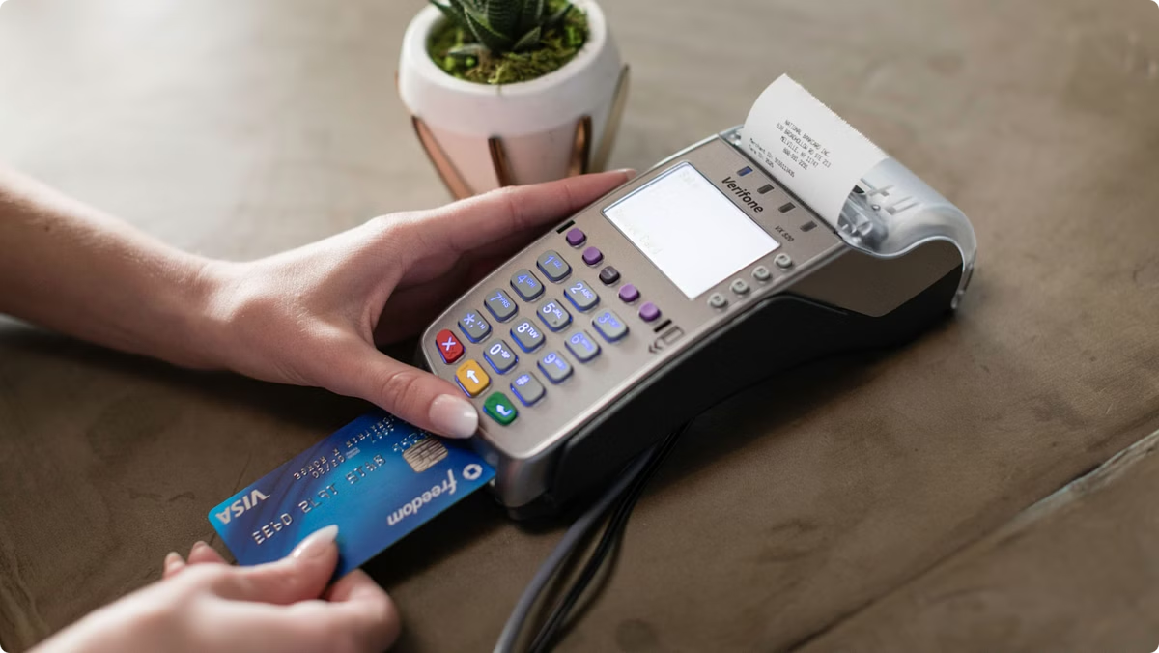
Payment Processing
Secure Payment Gateway
The system integrates with a secure payment gateway, ensuring safe and efficient processing of credit card and other payment methods.
Multiple Payment Options
Guests can choose from various payment methods, including credit cards, debit cards, and digital wallets, offering flexibility and convenience.
Real-Time Payment Confirmation
Real-time payment confirmation provides immediate feedback, confirming successful payment and ensuring smooth transaction completion.

Slide 7

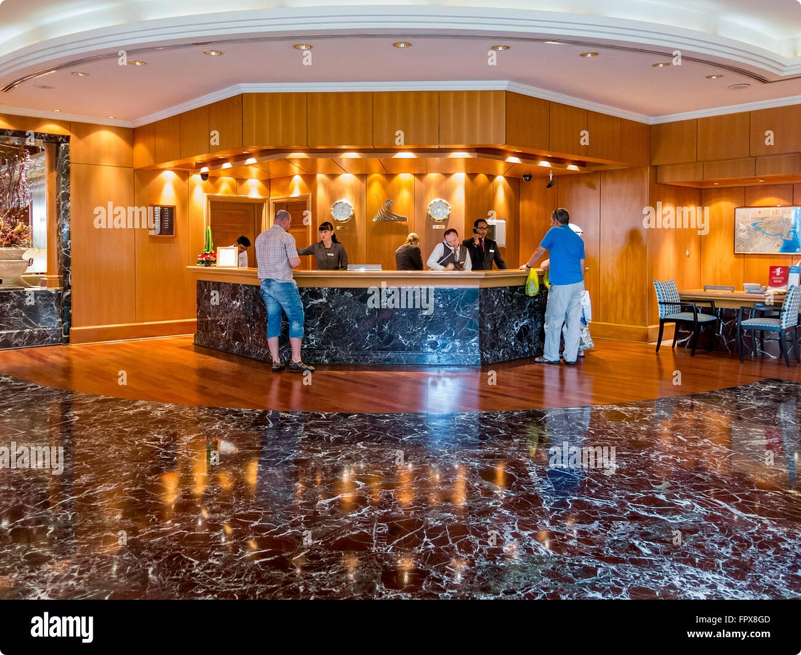
Customer Service Integration
No Waiter Interactions
You will never have to deal with the waiter or wait for him for ordering also you wouldn’t need for calling waiter for any help or argument.
Order History
Maintain a record of each guest's order history, allowing for personalized recommendations and repeat orders.
Guest Preferences
Everything here is completely errorless with no extra wastage of the precious time or anyone.

Slide 8
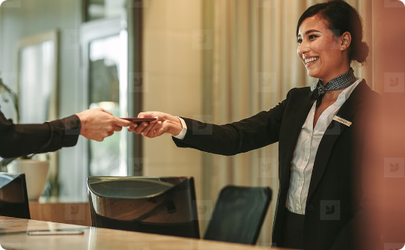
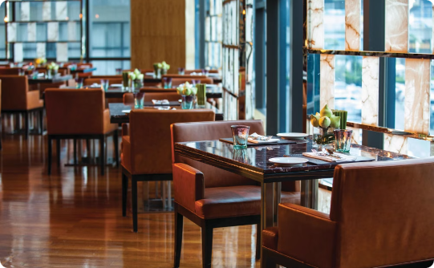
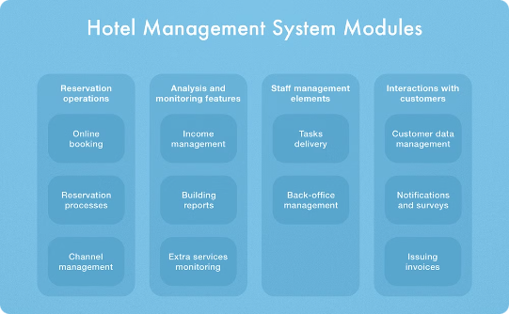
Benefits of the System
Enhanced Efficiency
Improved Customer Satisfaction
Data-Driven Insights
Streamlines order taking, processing, and billing, reducing errors and improving operational efficiency.
Provides valuable data on ordering patterns, customer preferences, and sales performance, enabling informed decision-making.
Provides a smooth and efficient ordering experience, leading to increased customer satisfaction and loyalty.

Slide 9

Conclusion
Whole Code - https://github.com/dev11062004/Java-Mini-Project
References Used - https://www.geeksforgeeks.org/java/
https://www.geeksforgeeks.org/java-projects/#inter

